Slide 1
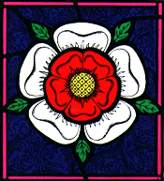
The Tudors
1485-1603

Slide 2
By the end of this unit, you will be able to ………
name and order the wives of Henry VIII
locate the Tudors within the context of the history of Britain
describe the appearance and character of Henry VIII
understand the power and importance of a Tudor king
identify what monarchs did and did not do

Slide 3
understand the reasons for royal marriages
distinguish between wealth and poverty in Tudor times
describe the lives of the poor in Tudor times

Slide 4
Who do you think this man was?

Slide 5
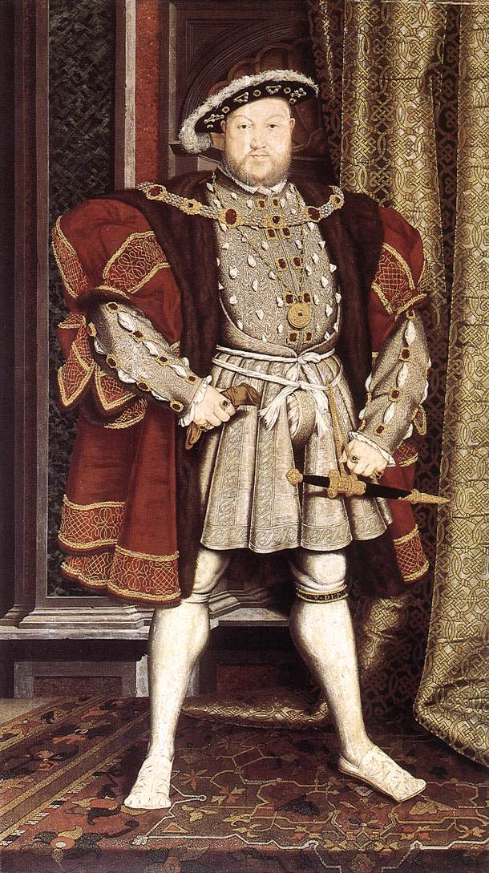

Slide 6
What do you know about him?

Slide 7
Catharine of Aragon 1509-1533
Married Henry VIII in 1509
She was a Catholic
She had a daughter called Mary who later became Queen Mary I

Slide 8
What do you think happened to her?
Clue : She was one of the lucky ones!

Slide 9
Divorced
Henry was growing frustrated by his lack of a male heir
Catherine was 42 years old and was no longer able to conceive

Slide 10
Anne Boleyn 1533-1536
She married Henry VIII secretly as his divorce was not quite through.
She gave birth to a daughter who later became Elizabeth I.
But…. no male heir.

Slide 11
What happened to her?
Clue : chop chop!

Slide 12
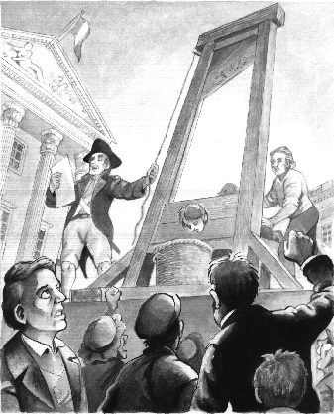
She was beheaded at Tower Hill.

Slide 13
Jane Seymour 1536-1537
Within 24 hours of Anne Boleyn's execution, Jane Seymour and Henry VIII were formally betrothed.
She gave Henry a son… Edward.

Slide 14
Unfortunately for the new Queen…….
She was not Henry’s last wife.
In 1537, she………………….

Slide 15
died

Slide 16
Anne of Cleves January 1540-July 1540
After a period of mourning, Henry sent men around western Europe to seek out a new wife for him. They were instructed to bring back portraits of the women they believed Henry would be interested in. Anne of Cleves was chosen from one such portrait.

Slide 17
Unfortunately…..
She did not look very much like her portrait and Henry did not find her attractive.
So he ………………….

Slide 18
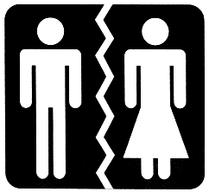
divorced her

Slide 19
Kathryn Howard 1540-1542
She was Anne Boleyn’s cousin
She was about 16 when she married Henry.
She was very pretty.

Slide 20
Henry saw her as perfect and unspoiled, a "rose without a thorn".
Rumour has it she had an affair whilst married to Henry.
Unfortunately for her….

Slide 21
Henry found out!

Slide 22
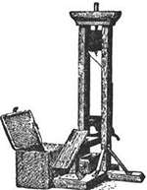
Kathryn Howard was beheaded in Feb 1542

Slide 23
Katherine Parr 1543-1548
Katherine Parr was the sixth and last wife of King Henry VIII
She was also the most intellectual of Henry's wives
She was in love with another man

Slide 24
Nothing!

Slide 25
Henry died

Slide 26
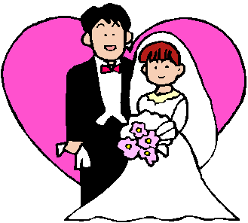
So she married the man she loved!

Slide 27
Henry’s Wives
Divorced : Catharine of Aragon
Beheaded : Anne Boleyn
Died : Jane Seymour
Divorced : Anne of Cleves
Beheaded : Kathryn Howard
Survived : Katherine Parr

Slide 28
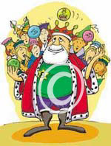
So, why do YOU think Henry married so many times?

