Slide 1
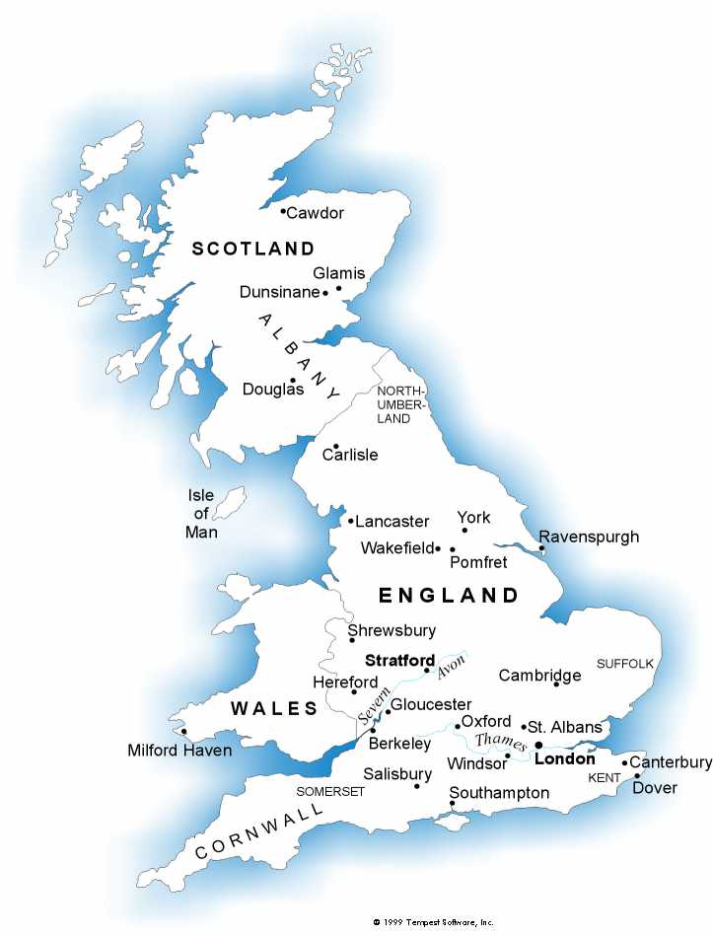
The Renaissance 1485-1660
Renaissance is French and means rebirth
Particular to renewed interest in learning
Also a renewal of the human spirit—of curiosity and creativity

Slide 2
Humanism
The Humanists went to old Latin and Greek classics to discover new answers to such questions as, “What is a human being?” “What is a good life”, etc.
Christianity provided complete answers to such questions
Humanists aim was to use the classics to strengthen, not discredit, Christianity
Humanists became teachers of the next generation’s rulers—wise and virtuous rulers, they hoped

Slide 3
New Technology: Print
Prior to type-set and computers, books were written by hand…a long and slow process
Guttenberg invented printing with movable type
He printed the first complete book—an immense Latin Bible around 1445
Print then spread to other cities in Germany and then Northern Italy
By 1500, relatively inexpensive books were available throughout Western Europe
1476-printing reached England

Slide 4
The reformation
While Renaissance is going on in England, in other countries in Europe the Reformation was going on
Renaissance and Reformation are closely related
One common feature of all Reformers: rejection of the authority of the Pope and the Italian churchmen
1530s England-a break with the Roman Church could no longer be avoided
People resented the financial burdens placed on them by the Vatican

Slide 5
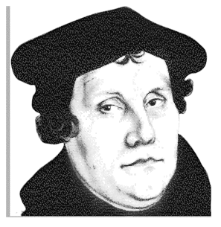
Martin luther 1483-1546
Martin Luther-monk
Founded a new kind of religion (can you name it?)
Based not on the teachings of the Vatican but on a personal understanding of the Bible
Church did need reform

Slide 6
King Vs pope: all for an heir
King Henry VIII wanted to divorce his wife, Catherine of Aragon (Spanish)
Church said NO!!
Catherine was previously married to Henry’s brother, Arthur (not the legendary Arthur)
Arthur dies, she marries Henry (there’s a story behind this, so listen)
She gave Henry a daughter, Mary (but 5 other babies had died)
Henry was in love with another (isn’t that always the story??)

Slide 7
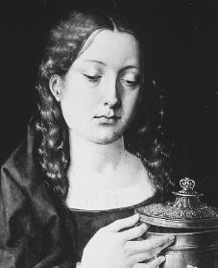
Catherine Fights back
Catherine fought back (naturally)
She refused to give Henry a divorce
Henry sends her away and puts her on house arrest and doesn’t allow her to see Mary
Pope refuses to grant Henry a divorce, despite Henry vowing to remove his allegiance to the Pope

Slide 8
Henry’s new church
Since the Pope wouldn’t grant Henry a divorce, Henry left the church
He made his own church—Church of England
He was the head of the Church, and called himself closest to God
Some people agreed, others didn’t
Thomas More, Lord Chancellor of England, disagreed with the King
Henry had him beheaded!
This fate fell to anyone who opposed Henry

Slide 9
So what about this new church?
Some felt that it wasn’t “new” but a copy of Catholicism (the old church)
The people who felt like this were:
Puritans
Baptists
Presbyterians
Dissenters
Nonconformists
They all made a new religion call Protestant—Martin Luther was the leader
Protestants said that religion was a relationship between that person and God

Slide 10
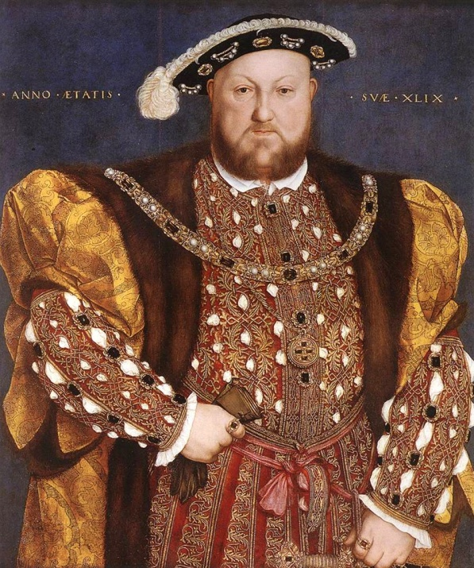
Alright, back to henry
Henry was a Renaissance man AND an executioner (if you didn’t agree with him, you died)
Married 6 times (yep, I’m getting to them)
3 kids (and to the kids, too)

Slide 11
Catherine of Aragon
Henry’s first wife, she’s from Spain
First married to Henry’s brother, Arthur (first in line to the throne)
Arthur dies and she marries Henry
She is Catholic and very faithful to the Pope
She doesn’t give Henry a son, but she does give him a daughter, Mary
Henry doesn’t need a daughter, he needs a son
Henry tries to divorce her, she refuses…and gets support from the Pope

Slide 12
Catherine of Aragon

Slide 13
Henry Divorces Catherine of Aragon in 1533
He still needs a male heir, though
So what does he do??
Yep, that’s right!
He finds himself another hunnie

Slide 14
Princess Mary

Slide 15
Anne Boleyn
Ann was a favorite of Henry’s at court
They had an affair while Henry was married to Catherine of Aragon, but one without sex
She was holding out for marriage…smart girl
It was all a set up by her father
Anne’s sister, Mary, had an affair with Henry first and bore him a son…but he was born out of wedlock and couldn’t be an heir to the throne
Anne’s father set it up so that Anne would be around Henry, Henry fell for it and fell for Anne
Anne wanted to assure her place, so there was no Hanky Panky

Slide 16
More on Anne
Anne and Henry were married
She gave him a daughter, Elizabeth
They kept trying for a son, but it was pointless…all the other babies died before being born
Henry was getting mad
Henry’s advisors told him that Anne was unfaithful to him (and she probably was)
Henry had to get rid of her…after all, he needed a male heir
So…what to do?

Slide 17
Princess Elizabeth

Slide 18
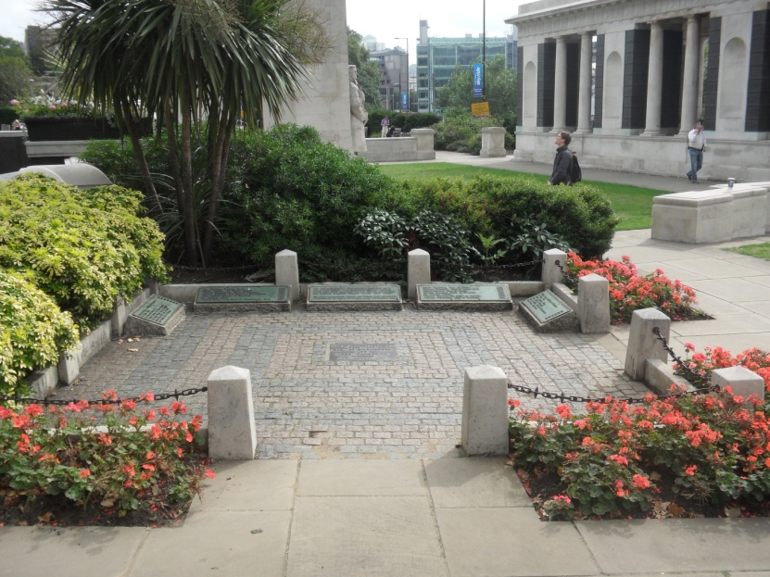
Poor Anne
Anne was found guilty of treason and Henry had her jailed at the Tower of London (it’s not a nice place)
Anne’s friends were also jailed as consorts to the crime
Anne’s brother and friend were both beheaded on Tower Hill

Slide 19
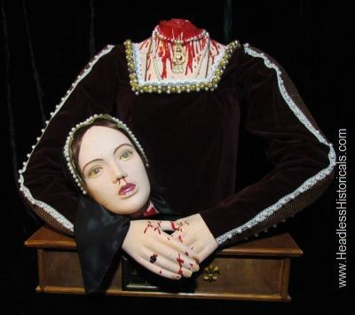
Anne loses her head
Henry had Anne beheaded inside the Tower of London

Slide 20
Tower of London
This is the spot where Anne was beheaded

Slide 21
Jane Seymour (not the actress)
Henry fell in love with Jane while Anne was tucked away in the Tower
They had an affair
They married the day after Anne was beheaded
Jane gave birth to a son, Edward
Henry was very happy
Jane dies 3 days later from complications of childbirth
Henry was devastated
Henry is buried next to Jane at St. George’s church at Windsor Castle

Slide 22
Jane…henry’s beloved

Slide 23
Prince Edward

Slide 24
Anne of Cleves
Henry’s marriage to Anne was arranged by Henry’s advisors
Anne was from Germany…England needed an alliance with Germany
Henry never met her before their wedding day
He didn’t like the way she looked
He divorced her, it was amicable
No kids
He gave her Anne Boleyn’s childhood home, which he seized after he killed her
Anne of Cleves lived there with Elizabeth

Slide 25
Anne of Cleves

Slide 26
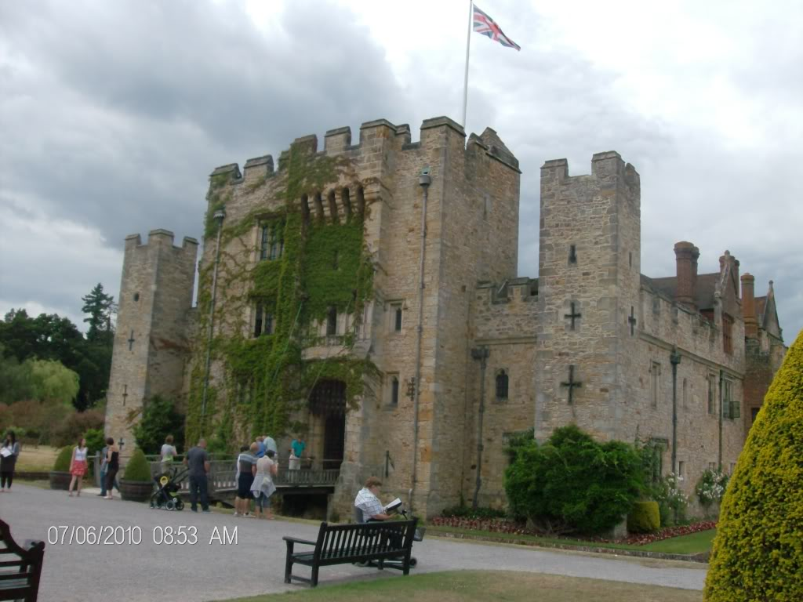
Hever Castle
Anne of Cleves lived here with Elizabeth

Slide 27
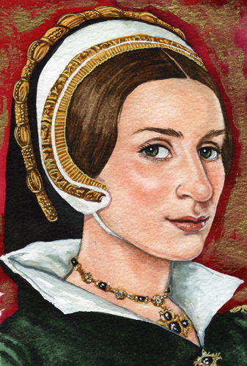
Catherine Howard
After Jane dies, Henry is very lonely
A very young Catherine Howard helps him occupy his time
He thinks she is young enough (she’s about 15 or so) to give him a male heir
She is repulsed by Henry’s smell and finds another man to occupy her time
Henry finds out and is furious
Guess what happens to her??

Slide 28
Yep, he beheads her

Slide 29
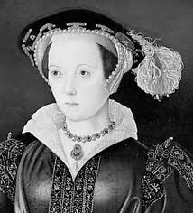
Catherine Parr
Henry is OLD! He smells because of the wound on his leg
Catherine Parr is old, too…and she is a widow
Henry needs companionship in his old age
He marries her
He dies
She….

Slide 30
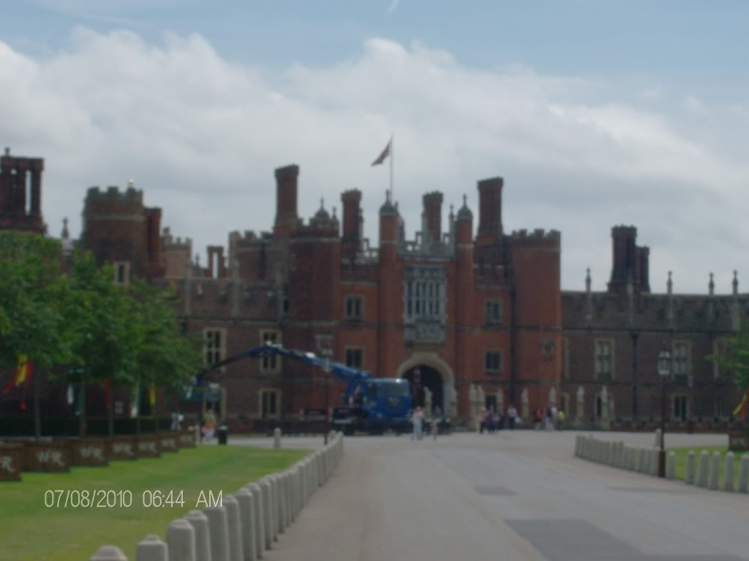
Survives
She lives happily ever after at Hampton Court, the home she shared with Henry

Slide 31
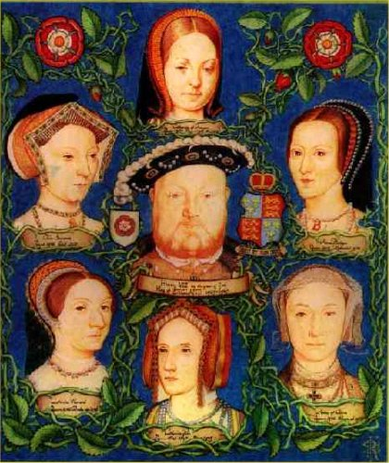
Here’s the song…
Divorced
Beheaded
Dies
Divorced
Beheaded
Survives

Slide 32
Henry’s Toilet
Hampton Court

Slide 33
Next Up…
The monarchy of King Edward
The monarchy of Queen Mary
And the most famous of all…
Queen Elizabeth I

